Slide 1
Misoperations in the West: Lay of the Land
Victoria L. Ravenscroft
Manager, Performance Analysis

Slide 2
Reducing Misoperations
Four Cornerstones
Information
Analysis
Partnership
Action
Information
Analysis
Partnership
Action

Slide 3
1. Information
Misoperations in the West
~ 300 misoperations per year
Rate between 5% and 6%
Top causes
Incorrect Settings
Relay Failures
Unknown
Incorrect Settings/Logic/Design
1
Relay Failures
2
3
Unknown
4
As-Left Personnel Error
5
AC System
6
Communication Failures
7
Other (Explainable)
8
DC System

Slide 4
2. Analysis
Misoperations by Cause 2013-2016
Average Index Score by Cause 2013-2016

Slide 5
3. Partnership
WECC analyzes information on misoperations for entire Interconnection…
BUT
Individual entities have the information on what happened and why…
AND
Technical subject matter experts have the knowledge to piece everything together

Slide 7
Overview
Approach
Intentional
Measurable
Industry-led
Flexible
Goal
Impactful and reasonable
Strategy
Principle-driven

Slide 8
Approach
Intentional
Measurable
Look back and determine how our actions effected the total number of misoperations
Industry-led
WECC and NERC don’t operate anything
Flexible
Actions must be reasonable; entities must be able to justify and perform the actions

Slide 9
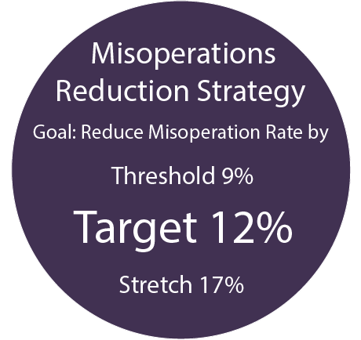
Goal
Impactful
Targeted reduction over next 3 to 5 years
Reasonable
3-tiered goal
Based on statistical analysis of historical information

Slide 10
Strategy
All contributors who can add value should be included
Inclusive
Impactful
Actions should cause positive change
Threshold 9%
Target 12%
Stretch 17%
Actions should be able to fit a range of entity types and sizes
Scalable
Measurable
Actions should be trackable and have identifiable results

Slide 11
Questions and Answers

